Slide 1
Software Version System
Part1: Subversion at CERN
Manuel Guijarro
Jonatan Hugo Hugosson
Artur Wiecek
October 2008
Notes:
Software version systems
Part1: Subversion at CERN

Slide 2
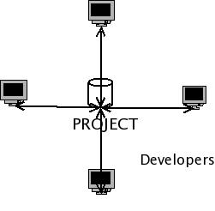
Version Control System
Maintain current and historical versions of files and data (source code)
Enables developers to work efficiently on same piece of code / project
  Check out
  Working copy
  Update
  Commit
  Merge
Why would I use it??

Slide 3
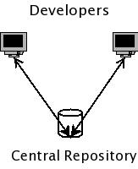
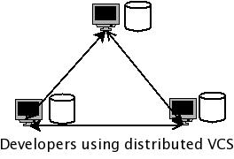
Version Control Systems
There are many VC Systems:
  Centralized VCS:
    CVS/SVN
  Distributed VCS:
    GIT, Bazaar, Darcs, Mercurial, etc
  Subversion is popular, used by GCC, Python, PuTTY, Apache, GNOME, KDE; and by Physics User Community: IN2P3, ROOT,TOTEM..
Notes:
There are other good software out there for doing Version Control. One of the famous ones is Git:
http://en.wikipedia.org/wiki/Git_%28software%29
..used for Linux Kernel developments, Xorg, etc. Git seems to have some advantages compared to SVN, but SVN also
has some advantages compared to Git:
http://git.or.cz/gitwiki/GitSvnComparsion
...mainly a wider range of user interface tools than Git and
better handling of binary files, ...it seems that there is no good Git client for windows.

Slide 4
CERN Central CVS Service
Hosts over 330 Software Projects
  29 for Atlas
  46 for CMS
  8 for LHCb,…..
Over 3000 developers registered
Over 90 GB of source code
Over 100000 commits per month
Notes:
Manuel, here you may add some stuff about CVS??? / hugo

Slide 5
Central CVS service features
High Availability
Load Balancing
Web interface to repositories
Usage Statistics
Daily archive of Repositories and DR
Developers Mailing list
Pre/Post Commit Actions (such us e-mail notification, etc)
Notes:
Disaster recovery: All repositories will be daily archive in Castor and the last 3 more recent versions of each repository will
Be copied to the Off-Site Backup servers in Prevessin for Total Disaster Recovery purposes

Slide 6
Motivation for SVN Pilot
CVS originally designed to host less than 100 projects
Requests to provide a central SVN service:
  From CMS
  From ATLAS (case study in 2006)
  And from many others
CVS is over 20 years old while SVN is this millennium technology
Requests for Read Access control
Notes:
The current CVS service has gone well beyond the target it was designed for. On top of that, we had got
Many requests from the user community asking for a central SVN service. There are already important software projects at CERN which are using non-IT managed SVN servers (ROOT and many other small ones).
Additionally, CVS is quite all technology and CVS server versions are not evolving so much (there is no new “feature” CVS version since July 2006) while SVN is just some 8 years old.
In the current CVS service, any user with a PLUS account can checkout the code of any of the hosted Software Projects. Atlas and

Slide 7
Using Subversion
$ svn help
…display all commands
$ svn checkout svn+ssh://svn.cern.ch/reps/ui
…checked out revision 234
$ cd ui
modify some file(s)…
$ svn commit –m “some use full comment”
...committed revision 235

Slide 8
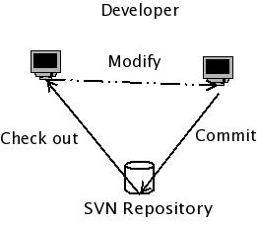
Subversion workflow

Slide 9
SVN vs. CVS
Feature | SVN | CVS
Speed | Faster | Slower
Permission | Full | Limited
File types | All | Limited
Off line operations | Yes | No
Repository format | Database | File system
Locks | No | Yes
Atomic commits | Yes | No
Notes:
Speed: It is faster since it transfer less data and uses a database as backend rather than a file system as CVS does
Atomic commits: SVN transactions either fully succeed or take no place. No locks are left behind and there is not need to handle them
Permission: Allow read access control (per repository and/or path)
File Types: It can handle even binary files. It performs binary diffs (CVS had to keep individual copies of binary files)
Add::??
Differences between Subversion and CVS
Revisions
Tags/Branches
SVN uses atomic commits, no locks
Move, rename and delete easily managed

Slide 10
Pilot Objectives
Provide current CVS service features
Add new features (available with SVN)
  Control Read access per path (module)
  Authenticated Web access
  Handling of binary files
Ease CVS to SVN migration
Handling of first line support via Help Desk
Leave all administrative tasks to Software Librarians of each project
Prevent uncontrolled setup of SVN servers
Notes:
Manuel, what was it you wanted to change manpower till???
CVS2SVN has many options which need to be customized for each librarian. Migration offers a good opportunity to cleanup.
There are tools to keep sync between CVS and SVN repositories such as Tailor:
http://wiki.darcs.net/DarcsWiki/Tailor
But CVS in sync with SVN can be quite painful, there is nothing which transfers diffs….
About uncontrolled setup of SVN servers, there are already quite a few out there: ROOT, ……

Slide 11
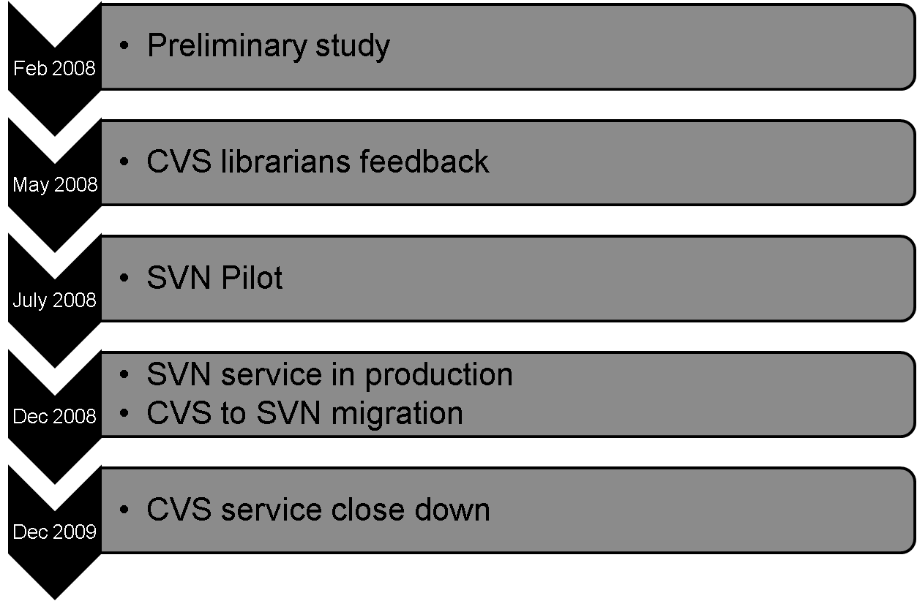
Timetable
Notes:
CHANGE???

Slide 12
Implementation
SSH access for SVN clients
  Authentication and authorization
  Secured:
    Restricted shell for all SVN clients
    Hooks chrooted
Web interface; websvn, trac
  Authentication and authorization
Configurations
  Set access rights to SVN client and web clients
  Administrate repository using the subversion tools

Slide 13
Support
URL: http://cern.ch/svn
  Try the pilot
  Documentation
Any queries
  hugosson@cern.ch
  Svn.support@cern.ch

Slide 14
Questions?
Thanks For Listening….
M. Guijarro, A. Wiecek, H. Hugosson

Slide 15
Implementation: Read / Write
[groups]
Dev = hugosson, guijarro
[/]
* = r
@Dev = rw
[/some/path]
* =
@Dev = rw
Notes:
Here I would set an example on how to restrict read access to a repository.

Slide 16
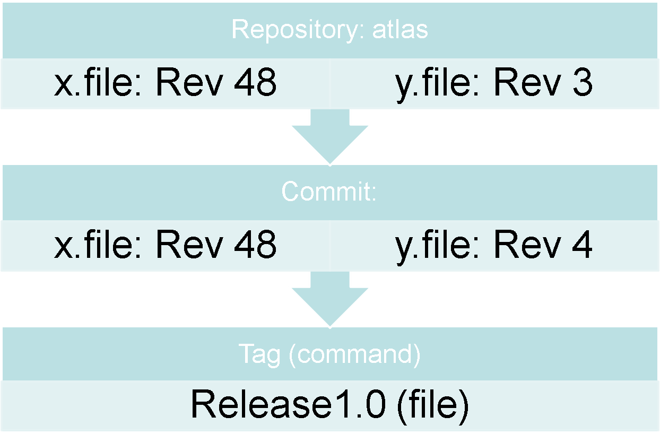
Tags/Revision: CVS

Slide 17
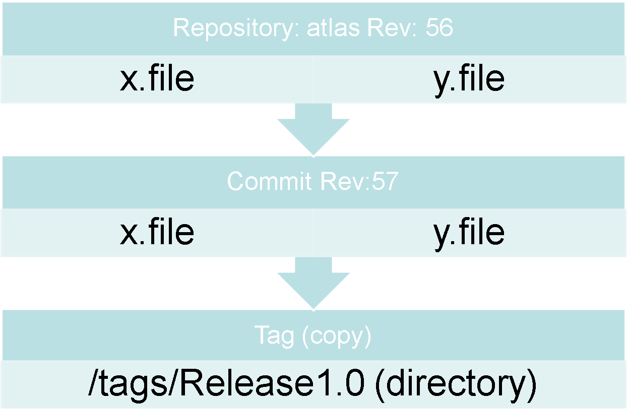
Tags/Revision: SVN

